Slide 1
Basketry in Spanish Culture
Student’s Name
Institutional Affiliation
Date

Slide 2
Introduction
Spain is one of the countries in Europe with a rich history of basketry.
Spanish basketry was mainly used in making utilitarian objects (receptables for domestic and carrying purposes) as well as household furniture.
Basketry was also used to make objects for decorative use.
This presentation explores the Spanish basketry culture explaining the different materials used in the past versus now.

Slide 3
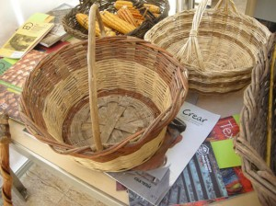
Materials used in the past
Notes:
In Galician Spain, most of the basketry was made from split wood and woven willow sides.
Basketry products were used to keep dry food, fruits, and grains.

Slide 4
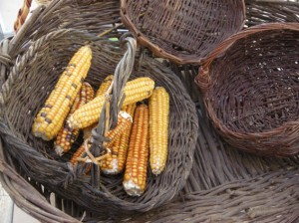
Galician baskets
Notes:
Traditional baskets were mainly used to store dry food like maize as shown above. They were also used to transport fish after arriving at the dock. Those making the baskets were the elderly.

Slide 5
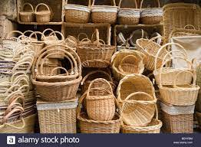
Traditional Spanish baskets

Slide 6
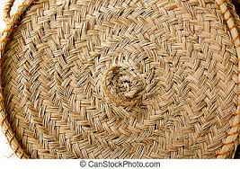
Woven baskets Techniques
Notes:
Woven baskets were common in Spain. This involved coiling, braiding, twisting, and weaving. Techniques used depended on the available material but fiber was particularly common. Coiling is the oldest technique and was used in Spain. Coiling started at the center, the sides and then the edges.

Slide 7
Modern basketry
A lot has changed throughout history in terms of basketry.
Today, baskets have been more decorated than in the past.
Today, there are household basketry objects that are receptables for preparing and serving food.
The baskets vary in shape and dimension.
Today, we have waterproof baskets unlike in the past and can be used to store liquids.
The waterproof technique is done through close plaiting.

Slide 8
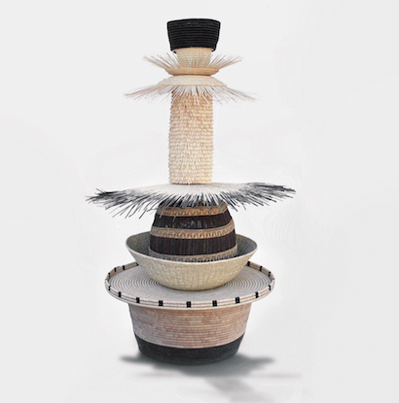
Modern baskets
Notes:
Modern baskets are made from natural materials but are given a finer touch that makes them more beautiful and attractive than the traditional ones.

Slide 9
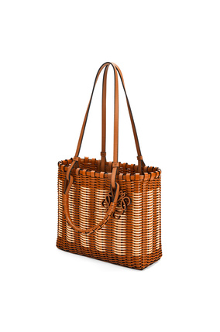
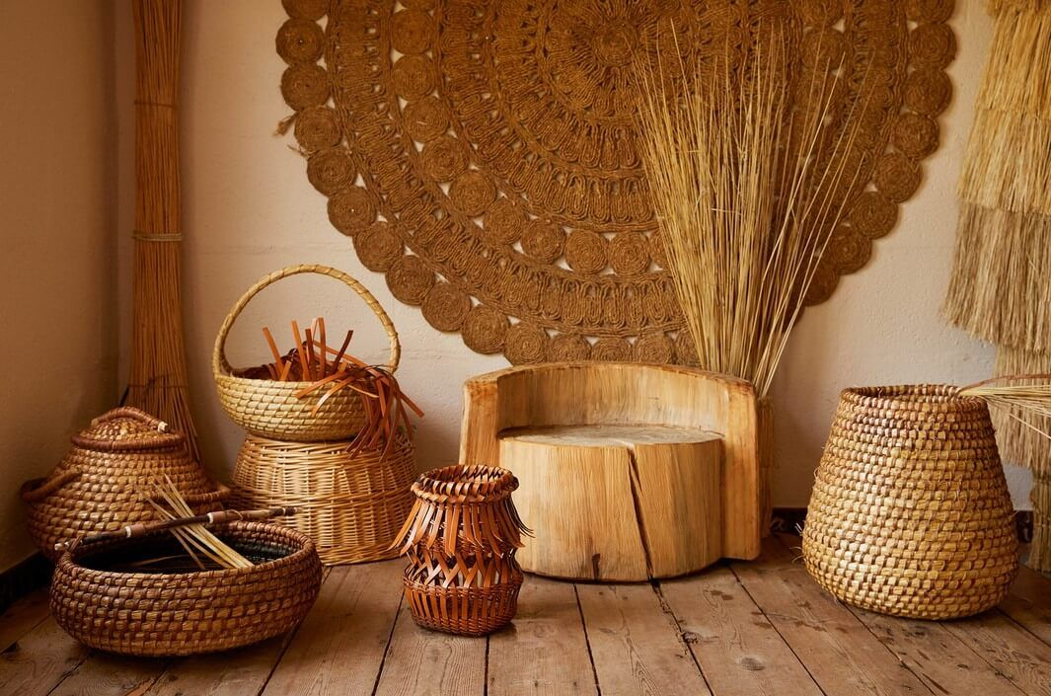
Loewe baskets
Notes:
Loewe are modern luxurious accessories crafted from leather. They are examples of modern basketry.

Slide 10
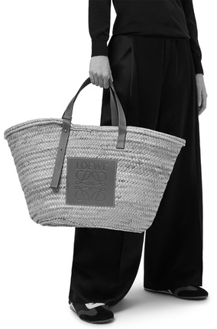
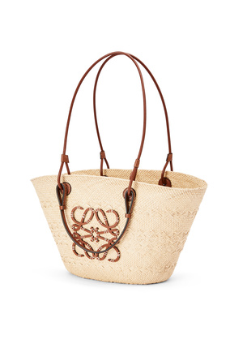
LOEWE baskets
Notes:
Loewe anagram basket bag in iraca palm and calfskin: modern basketry. Loewe baskets are made from natural materials like elephant grass, palm leaves, agave, and sisal.

Slide 11
Conclusion
Modern basketry is known for its flexibility, permeability, lightness and solidity.
It has utilitarian ends because they are handmade and luxurious.
It is cheap and does not require investment.
Thus, even in the modern industrial world with a lot of technology, basketry still has its place.

Slide 12
References
Mason, O. T. (1988). American Indian Basketry. Courier Corporation.
Romero-Brugués, S., Huerta, R. P., & Herrero-Ortal, M. (2021). The basketry at the early Neolithic site of La Draga (Banyoles, Spain). Journal of Archaeological Science: Reports, 35, 102692.
Zoran, A. (2013). Hybrid basketry: interweaving digital practice within contemporary craft. In ACM SIGGRAPH 2013 Art Gallery (pp. 324-331).

